Slide 1
Building an E-commerce Presence:
Web Sites, Mobile Sites, and Apps
Slide 4-<number>

Slide 2
E-commerce Presence
E-commerce presence refers to the online visibility and availability of a business or organization that sells products or services over the internet. It includes all the digital platforms and channels through which a business interacts with customers, showcases its offerings, and conducts transactions.
Key Components of an E-commerce Presence:
Website (Main Hub)
  A professional e-commerce website is the core of your online presence.
  Example: An online clothing store with product pages, a shopping cart, and checkout functionality.
Mobile Presence
  Mobile-optimized websites or dedicated mobile apps.
  Example: A food delivery app that allows users to place orders on their smartphones.

Slide 3
E-commerce Presence
Social Media
  Platforms like Facebook, Instagram, YouTube, or TikTok used for marketing, customer engagement, and even direct selling.
  Example: A cosmetics brand selling products through Instagram Shops and promoting via influencers.
Email Marketing
  Direct communication with customers via newsletters and promotional emails.
  Example: Sending weekly product recommendations or special discount codes to subscribers.
Search Engine Presence
  Visibility through search engines like Google, using SEO and paid ads (e.g., Google Ads).
  Example: An electronics store appearing on the first page of Google when someone searches “buy laptop online.”
Online Marketplaces
  Selling through third-party platforms like Amazon, eBay, or Etsy.
  Example: A small business selling handmade crafts on Etsy.

Slide 4
Why E-commerce Presence is Important?
Reach a wider audience beyond physical boundaries.
Improve brand visibility and trust.
Increase sales by making it easy for customers to find and buy products.
Enhance customer engagement through multiple digital touchpoints.

Slide 5
Reach a Wider Audience Beyond Physical Boundaries
In a traditional brick-and-mortar setup, your business is limited by geography. However, an e-commerce presence removes these barriers and allows you to:
Sell to customers worldwide, 24/7, regardless of location or time zone.
Tap into new markets without the cost of setting up physical stores.
Cater to niche segments that may not exist in your local area but have strong demand elsewhere.
Example:
A boutique in Rajshahi can now sell handcrafted sarees to customers in Dhaka, Dubai, or even New York through an online store.

Slide 6
Improve Brand Visibility and Trust
Having a professional and active digital presence builds brand credibility and keeps your business top-of-mind for consumers. Here's how:
A well-designed website, consistent branding, and active social media pages signal that your business is legitimate and trustworthy.
Positive online reviews, testimonials, and user-generated content increase social proof.
Search engine optimization (SEO) ensures that customers find your brand when they search online.
Example:
If someone searches "organic honey in Bangladesh," your brand appears in the top search results due to a strong web presence—instantly improving visibility and trust.

Slide 7
Increase Sales by Making it Easy for Customers to Find and Buy Products
A strong e-commerce presence simplifies the shopping process and boosts conversion rates:
Customers can search, compare, and purchase products in just a few clicks.
Features like personalized recommendations, shopping carts, and secure payment gateways make it convenient and efficient.
You can run targeted promotions and offer discounts to attract and retain buyers.
Example:
A user browsing Instagram sees a sponsored ad for your t-shirt brand, clicks the link, views product options on your website, and checks out within minutes—all without ever visiting a store.

Slide 8
Enhance Customer Engagement Through Multiple Digital Touchpoints
With an e-commerce presence, businesses can connect and interact with customers through various channels, leading to stronger relationships:
Social media lets you run polls, reply to comments, or share behind-the-scenes content.
Live chat or chatbots on your website allow real-time support.
Email newsletters keep customers informed about new arrivals, sales, and personalized offers.
Example:
A customer adds an item to their cart but doesn’t complete the purchase. Later, they receive an automated email reminding them to check out—this small engagement could lead to a sale.

Slide 9
Imagine Your E-commerce Presence
Determine the vision of your Business
What is the idea?
Before building an e-commerce presence, it's essential to have a clear vision. This vision should outline your mission, target audience, market space, strategic analysis, marketing plan, and a development timeline with a preliminary budget. It begins with an idea of what's possible and ends with a practical plan for implementation.

Slide 10
What is the idea?
Example:
Imagine a startup planning to launch an e-commerce store that sells eco-friendly clothing. Before building the website, the founders develop a clear vision:
Mission: To make sustainable fashion affordable and accessible to everyone.
Target Audience: Environmentally conscious young adults aged 18–35 in urban areas.
Market Space: The sustainable fashion niche within the broader online apparel industry, focused initially on North America.

Slide 11
What is the idea?
Strategic Analysis (SWOT):
  Strengths: Unique eco-friendly materials, transparent supply chain.
  Weaknesses: New brand with no established reputation.
  Opportunities: Growing demand for ethical fashion.
  Threats: Competition from established brands going green.
Marketing Matrix: Using Instagram and TikTok for awareness, influencers for trust-building, and targeted ads for conversions.
Development Timeline & Budget: A 6-month plan including design, product sourcing, marketing, and launch, with an estimated budget of $50,000.
With this vision in place, the team avoids missteps, stays aligned, and executes their e-commerce presence effectively.

Slide 12
Where’s the $$money?
To build a sustainable e-commerce presence, you need to be clear on:
Business model(s):
Portal, e-tailer, content provider, transaction broker, market creator, service provider, community provider
Revenue model(s):
Advertising, subscriptions, transaction fees, sales, and affiliate revenue
Why It Matters:
Clearly defining where the money comes from helps:
  Build a solid business plan
  Attract investors or partners
  Set pricing strategies
  Forecast future revenue and growth

Slide 13
Who and where is the target audience?
Understanding your audience is key to delivering the right product, message, and experience. Below are the core dimensions for profiling your e-commerce audience:
Demographics
Demographics provide basic statistical data about your potential customers. These are often the first criteria used to segment and define an audience.
Key Elements:
Age: Are they teens (13–19), millennials (20–35), adults (36–55), or seniors (55+)?
Gender: Are your offerings more appealing to men, women, or all genders?
Income: Determines affordability and purchasing behavior (low, middle, or high-income segments)
Location: Urban vs. rural; local, national, or global; cultural context may vary

Slide 14
Characterize the marketplace
To imagine your e-commerce presence effectively, one important step is to characterize the marketplace where you will operate. This involves analyzing the environment in which your business will function — understanding the market's structure, key players, and dynamics.
Demographics
This refers to the statistical characteristics of your target market or customer base, which influence buying behavior.
Age: Are you targeting teens, adults, or seniors?
Gender: Is your product more appealing to males, females, or all genders?
Income Level: Are you selling premium or budget-friendly items?
Education Level, Occupation, Lifestyle: These help shape marketing tone, product design, and platform usability.
Example: A platform selling premium smartwatches might target tech-savvy, urban professionals aged 25–45 with mid-to-high income.

Slide 15
Characterize the marketplace
Size, Growth, Changes
Understand the current market size, whether it is growing, stagnant, or declining, and what trends are influencing change.
Size: What is the estimated number of potential customers or total revenue of the market?
Growth Rate: Is the market expanding year over year?
Trends: Are there technological shifts, changing customer expectations, or regulatory changes?
Example: The global online grocery market is growing due to increased smartphone use and convenience culture.
Structure
Defines how the market is organized and who the dominant players are.
Is the market fragmented or monopolized?
Is there room for new entrants?
How easy is it for a customer to switch between competitors?
Example: The ride-sharing market is dominated by Uber and Lyft, but smaller regional apps can still find a niche.

Slide 16
Characterize the marketplace
Competitors
Identify direct and indirect competitors and assess their strengths and weaknesses.
What are they offering?
What’s their market share?
How do they price and promote their products?
What is their unique value proposition?
Example: For an online bookstore, Amazon is a direct competitor. Indirect competitors could be audiobook platforms like Audible.

Slide 17
Characterize the marketplace
Suppliers
Suppliers provide the goods or services you will sell or use to operate your platform.
Are suppliers local or international?
Do they offer reliable delivery and quality?
How dependent is your business on them?
Can you switch suppliers easily?
Example: A dropshipping e-commerce site might rely on Chinese manufacturers through platforms like AliExpress.

Slide 18
Characterize the marketplace
Substitute Products
These are alternative products or services that can meet the same customer needs.
Are customers already solving this problem differently?
What would convince them to switch to your offering?
Example: Instead of buying gym equipment online, customers may choose digital fitness subscriptions like Peloton.

Slide 19
Characterize the marketplace
Where is the Content Coming From?
The source and nature of your website content plays a big role in user engagement and SEO.
User-generated: Reviews, photos, comments (e.g., Amazon, Yelp).
Business-generated: Product descriptions, blog posts, videos.
Automated feeds: Affiliate or dropshipping databases.
Example: A fashion store may use both in-house editorial content and customer reviews to build trust.

Slide 20
Characterize the marketplace
Static or Dynamic Web Pages?
The type of content delivery affects website performance, flexibility, and user experience.
Static pages: Fixed content (about pages, terms of service). Fast and simple.
Dynamic pages: Content is generated in real-time based on user interaction or database entries (product pages, user dashboards, personalized recommendations).
Example: A product page that changes price based on location or shows “items left in stock” is dynamic.

Slide 21
Know yourself—SWOT analysis
"Know yourself — SWOT analysis" in the context of e-commerce presence means evaluating your online business's internal strengths and weaknesses, as well as the external opportunities and threats it faces. This helps you understand your current position, make strategic decisions, and improve your competitiveness in the digital marketplace.
  Strength
  Weakness
  Opportunities
  Threats

Slide 22
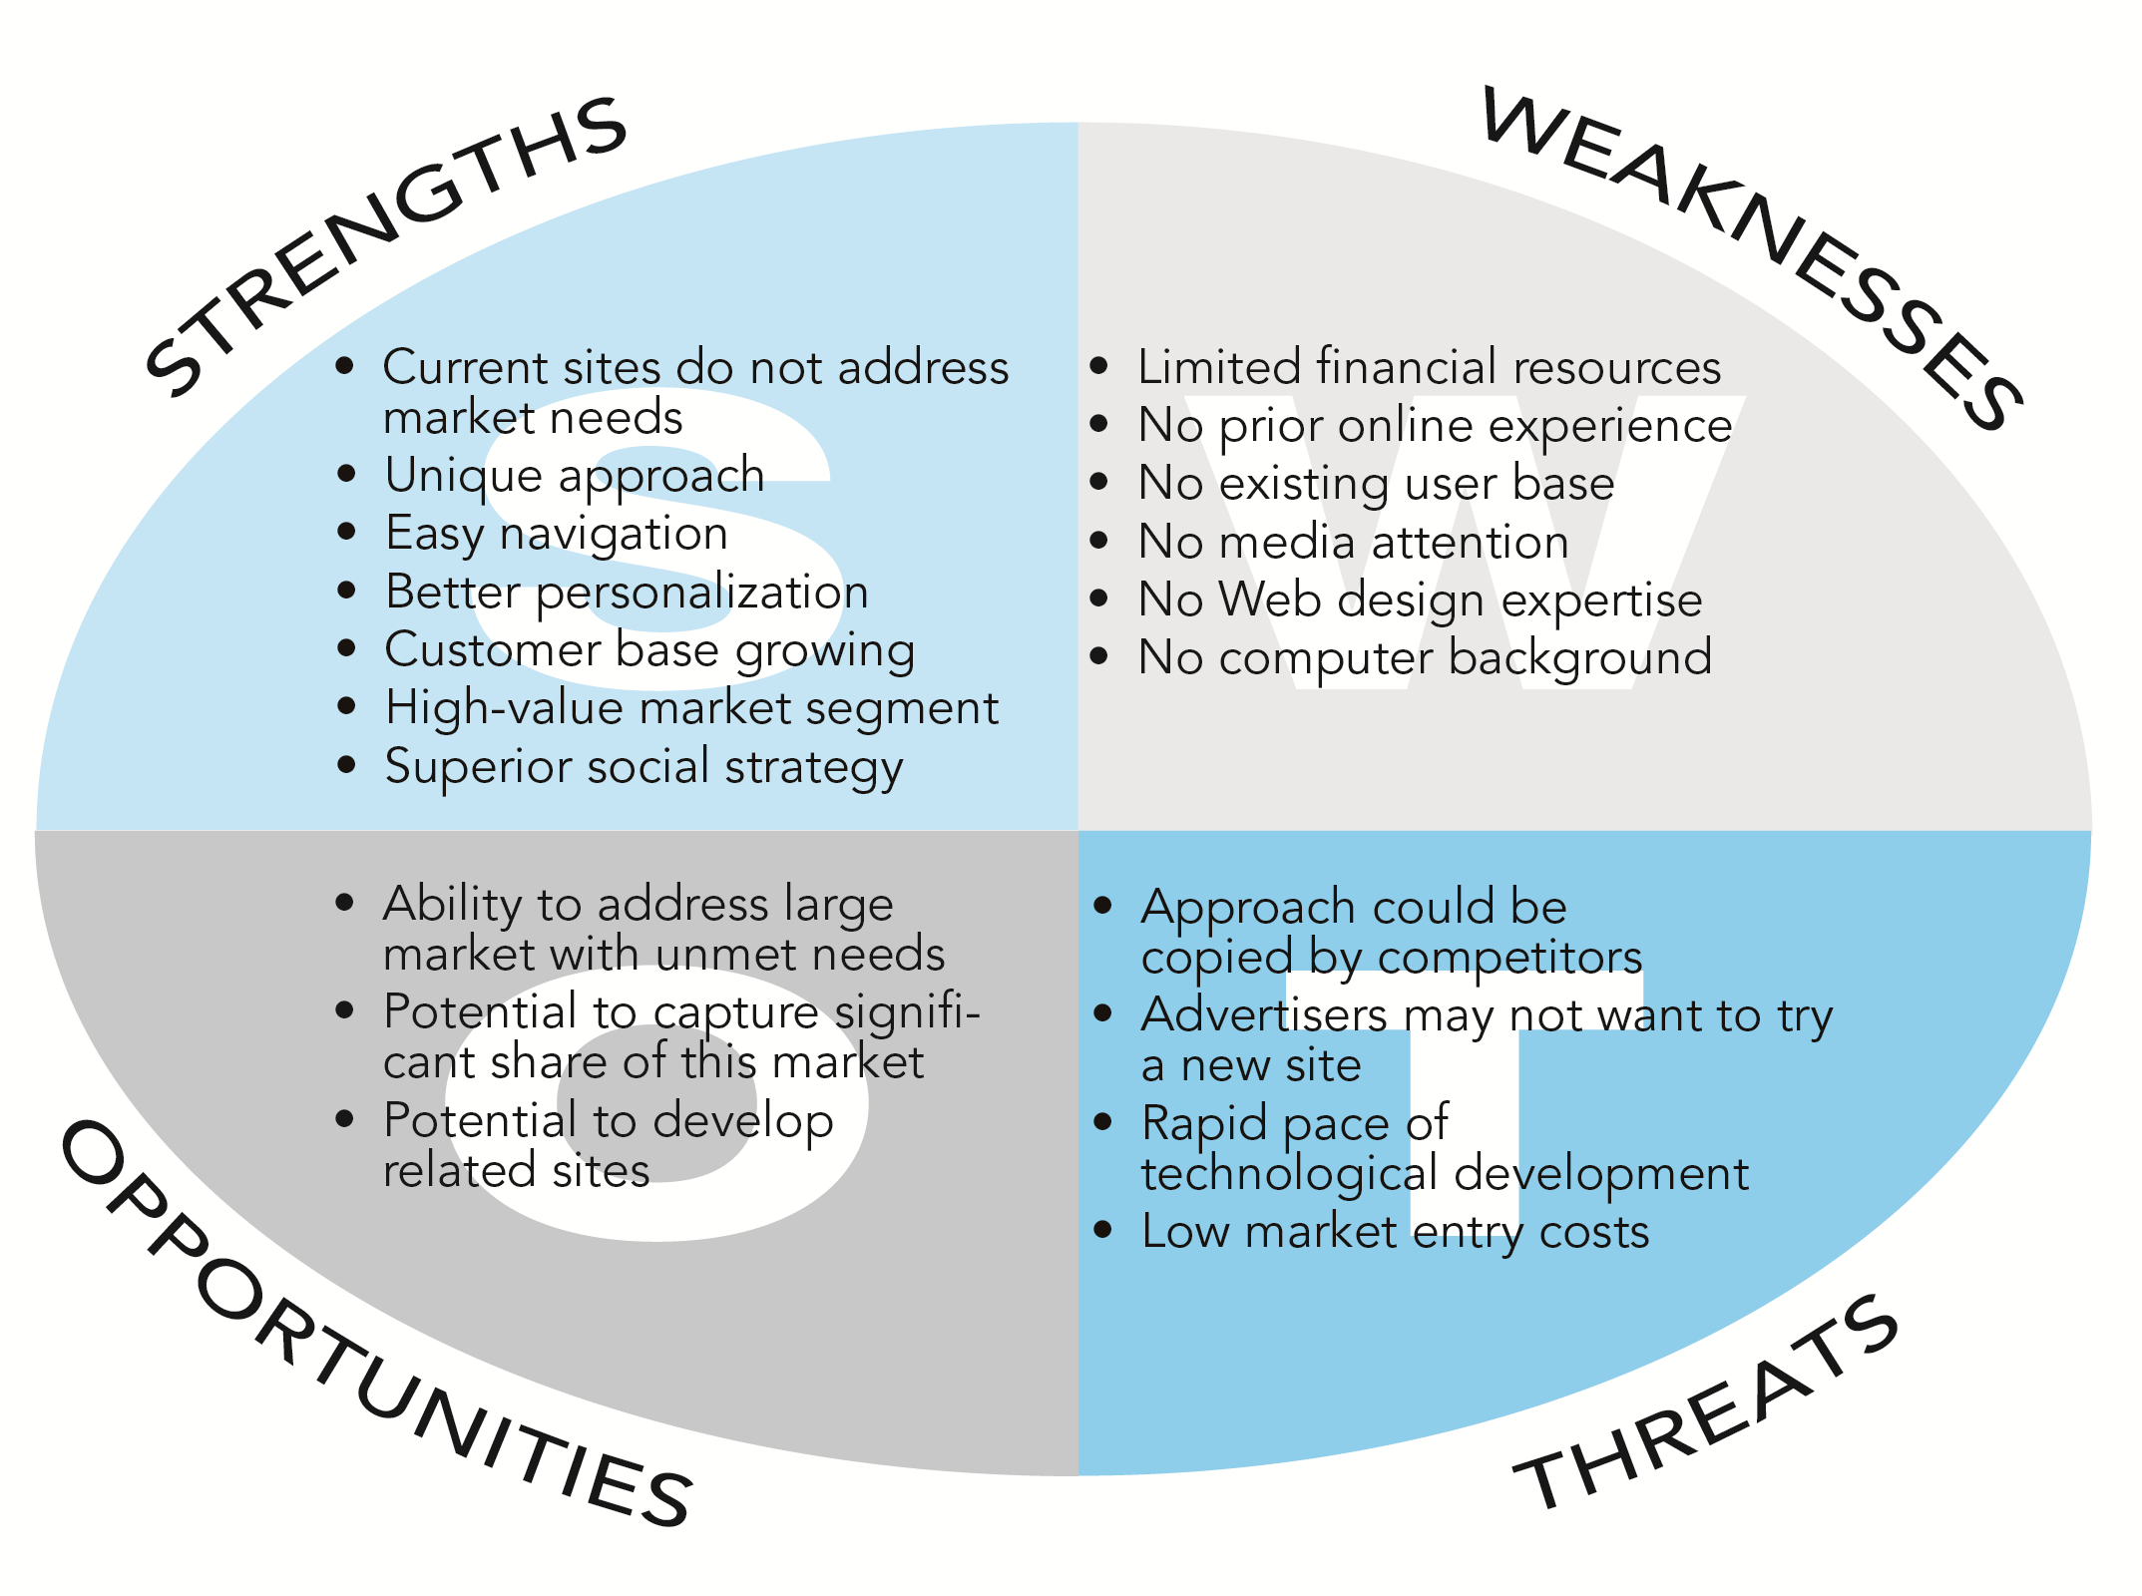
SWOT Analysis

Slide 23
Know yourself—SWOT analysis
Strengths (Internal, Positive Factors)
These are the internal capabilities and advantages that give your e-commerce business a competitive edge.
Examples:
Strong Brand Recognition: A popular fashion e-commerce site like Zara.com benefits from high brand trust and repeat customers.
Efficient Supply Chain: Amazon has an advanced logistics and fulfillment system, enabling fast delivery.
User-Friendly Website or App: A clean, fast-loading interface with smooth navigation increases user satisfaction (e.g., Shopify-powered stores).
Diverse Product Range: Offering a wide range of products increases customer retention (e.g., AliExpress).

Slide 24
Know yourself—SWOT analysis
Weaknesses (Internal, Negative Factors)
These are limitations within the business that hinder growth or reduce performance.
Examples:
Poor Website UX/UI: A cluttered or slow website can lead to high bounce rates.
Limited Payment Options: If your e-commerce store doesn’t support mobile payments or local currencies, it may lose customers.
Low Inventory Management: Inaccurate stock data can cause frequent "out-of-stock" messages, frustrating customers.
Lack of Digital Marketing Expertise: Without effective SEO, SEM, or social media strategies, your business may struggle to attract traffic.

Slide 25
Know yourself—SWOT analysis
Opportunities (External, Positive Factors)
These are favorable external conditions that your business can exploit to gain advantage.
Examples:
Growing Mobile Commerce: More users shopping via smartphones—optimize for mobile to boost conversions.
New Market Segments: Selling eco-friendly products in regions with rising environmental awareness.
Government E-commerce Incentives: For instance, digital infrastructure support in developing countries.
Global Reach: With the internet, you can easily expand beyond local markets (e.g., using platforms like Etsy or Amazon Global).

Slide 26
Know yourself—SWOT analysis
Threats (External, Negative Factors)
These are external elements that could cause problems for your e-commerce business.
Examples:
Intense Competition: Big players like Amazon, Walmart, or niche brands with loyal customers.
Cybersecurity Risks: Threats like data breaches or online fraud can damage customer trust.
Changing Regulations: Tax laws, data privacy (e.g., GDPR), or shipping restrictions can complicate operations.
Customer Behavior Shift: Consumers may prefer social commerce (shopping via platforms like Instagram or TikTok), affecting traditional e-commerce traffic.

Slide 27
Imagine Your E-commerce Presence (cont.)
Know yourself—SWOT analysis
Develop an e-commerce presence map (Fig 4-2)
Develop a timeline: Milestones
How much will this cost?
  Simple Web sites: up to $5000
  Small Web start-up: $25,000 to $50,000
  Large corporate site: $100,000+ to millions

Slide 28
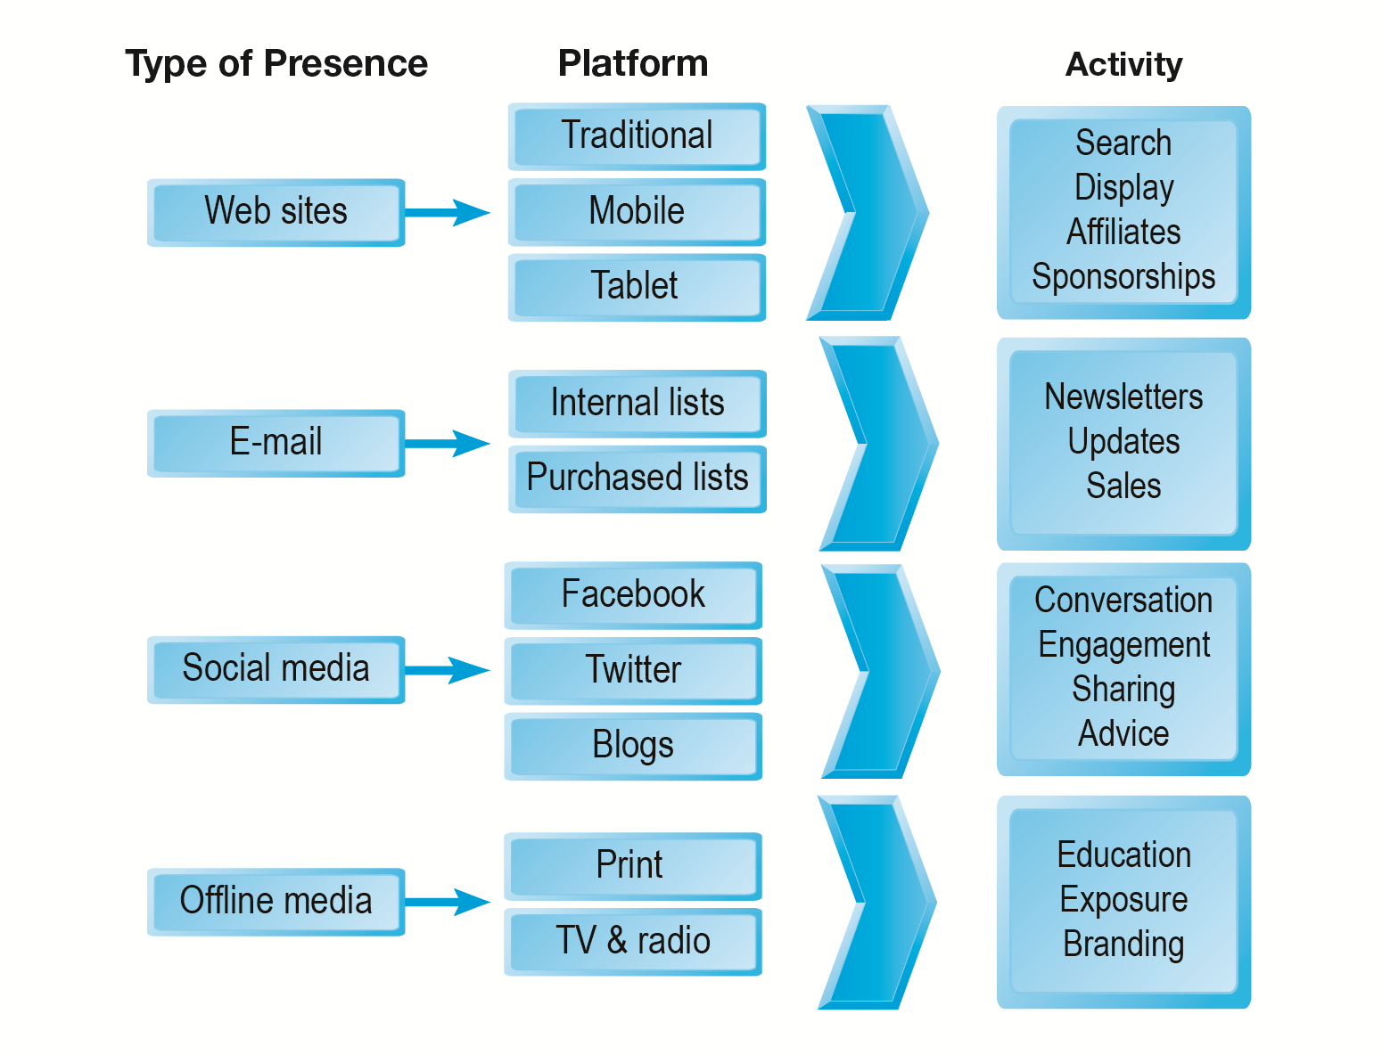
E-commerce Presence Map

Slide 29
Building an E-commerce Site:
A Systematic Approach
Most important management challenges:
  Developing a clear understanding of business objectives
  Knowing how to choose the right technology to achieve those objectives

Slide 30
Pieces of the Site-Building Puzzle
Main areas where you will need to make decisions:
  Human resources and organizational capabilities
    Creating team with skill set needed to build and manage a successful site
  Hardware/Software
  Telecommunications
  Site design

Slide 31
The Systems Development Life Cycle
Methodology for understanding business objectives of a system and designing an appropriate solution
Five major steps:
  Systems analysis/planning
  Systems design
  Building the system
  Testing
  Implementation

Slide 32
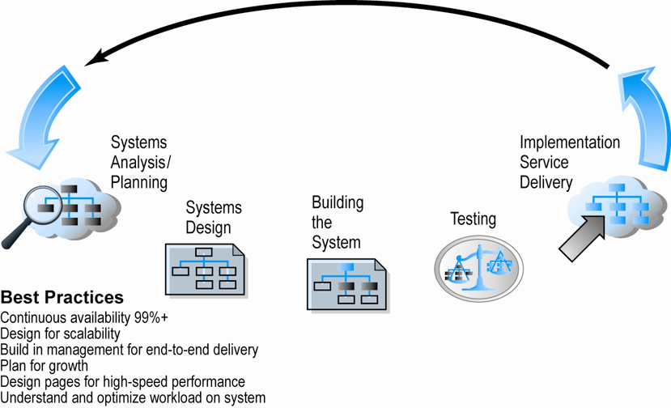
Web Site Systems Development Life Cycle

Slide 33
System Analysis/Planning
Business objectives:
  List of capabilities you want your site to have
System functionalities:
  List of information system capabilities needed to achieve business objectives
Information requirements:
  Information elements the system must produce in order to achieve business objectives

Slide 34
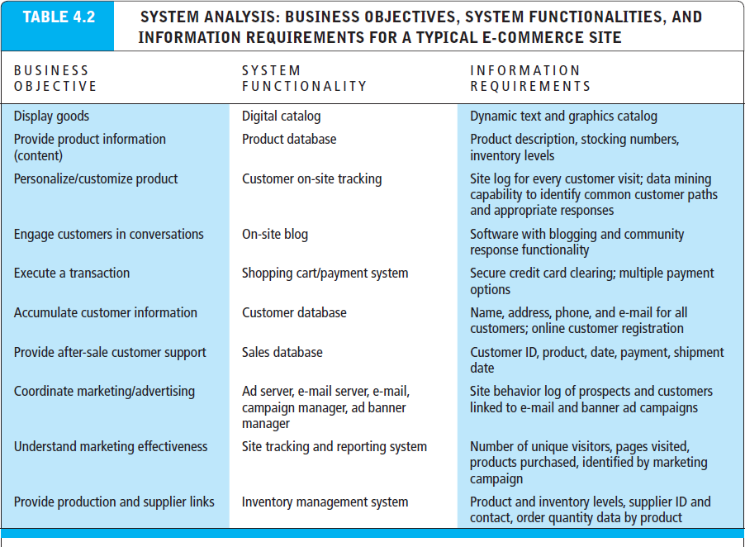

Slide 35
Systems Design:
Hardware and Software Platforms
System design specification:
  Description of main components of a system and their relationship to one another
Two components of system design:
  Logical design
    Data flow diagrams, processing functions, databases
  Physical design
    Specifies actual physical, software components, models, and so on

Slide 36
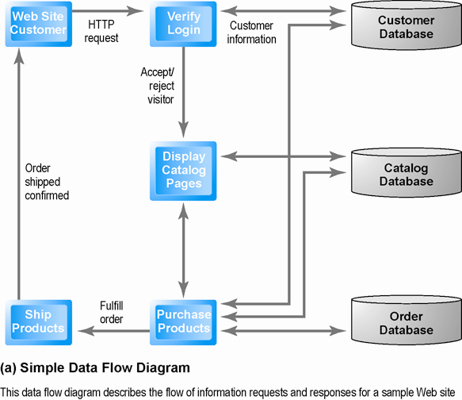
Logical Design for a Simple Web Site

Slide 37
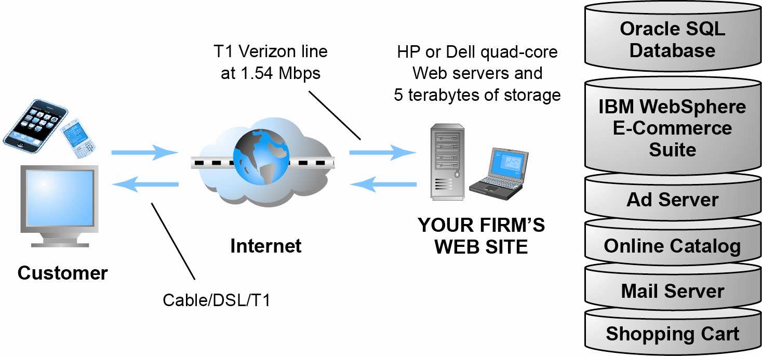
Physical Design for a Simple Web Site

Slide 38
Build/Host Your Own vs. Outsourcing
Outsourcing: Hiring vendors to provide services involved in building site
Build own vs. outsourcing:
  Build your own requires team with diverse skill set; choice of software tools; both risks and possible benefits
Host own vs. outsourcing
  Hosting: Hosting company responsible for ensuring site is accessible 24/7, for monthly fee
  Co-location: Firm purchases or leases Web server (with control over its operation), but server is located at vendor’s facility

Slide 39
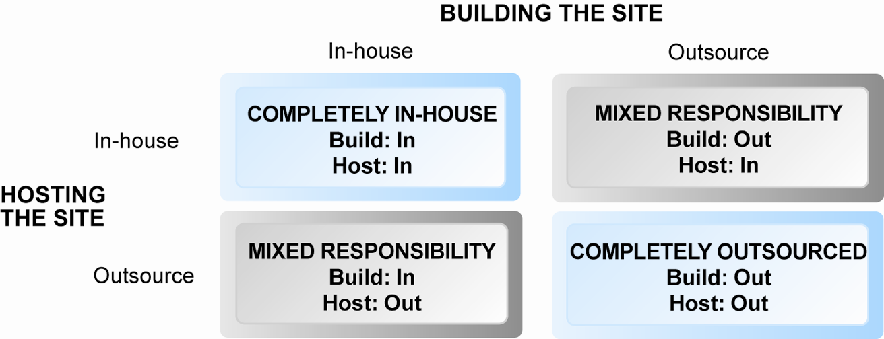
Choices in Building and Hosting

Slide 40
Testing, Implementation, and Maintenance
Testing
  Unit testing
  System testing
  Acceptance testing
Implementation and maintenance:
  Maintenance is ongoing
  Maintenance costs: Similar to development costs
  Benchmarking

Slide 41
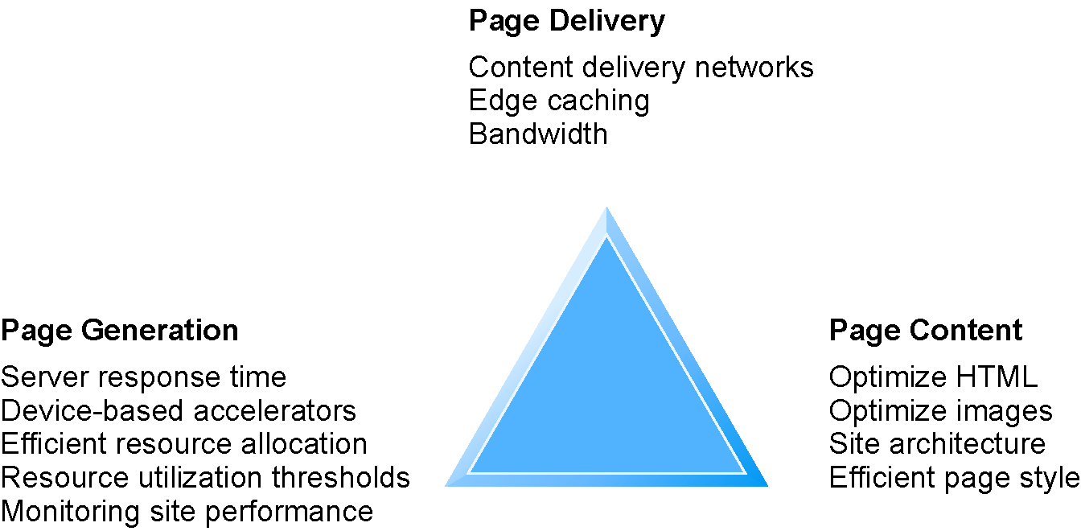
Factors in Web Site Optimization
Notes:
Edge caching refers to distributing content from local web servers to caching servers that are closer to the end users (i.e., near the edge)

Slide 42
Simple vs. Multi-tiered
Web Site Architecture
System architecture
  Arrangement of software, hardware, and tasks in an information system needed to achieve a specific functionality
Two-tier
  Web server and database server
Multi-tier
  Web application and other servers
  Backend, legacy databases

Slide 43
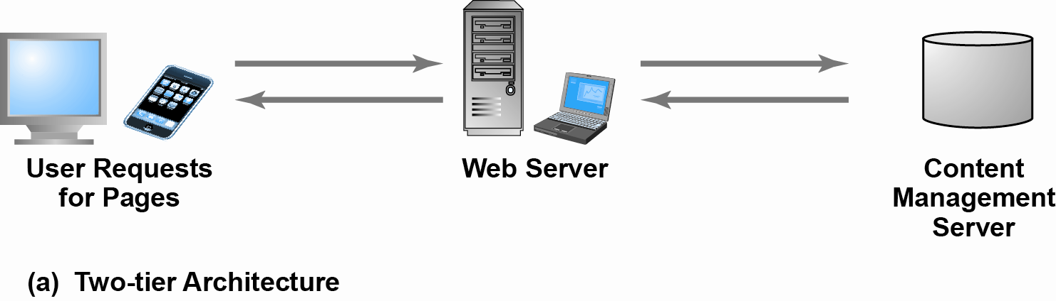
Two-Tier E-commerce Architecture

Slide 44
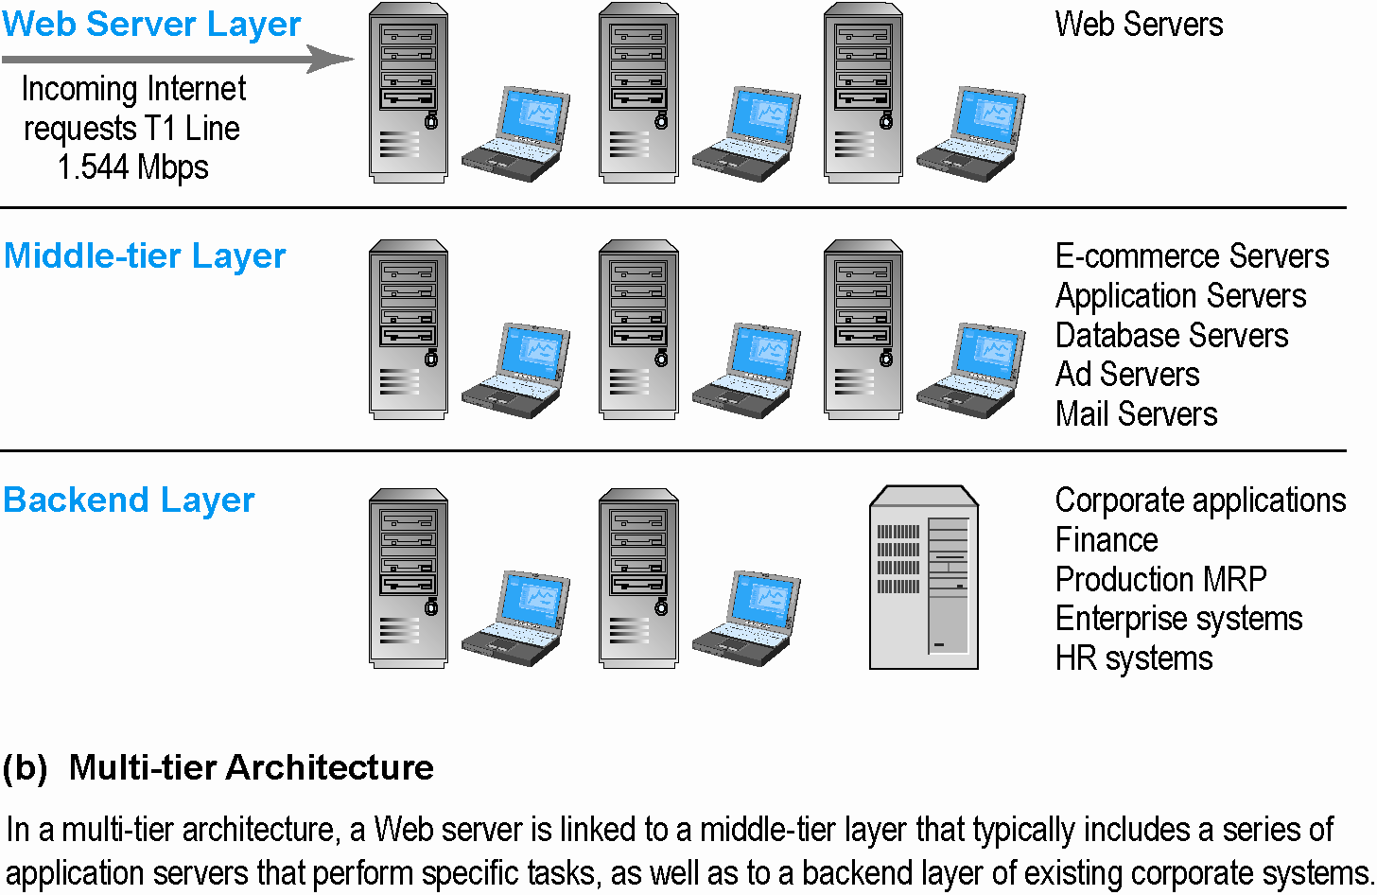
Multi-Tier E-commerce Architecture

Slide 45
Web Server Software
Apache
  Leading Web server software (47% of market)
  Works with UNIX, Linux operating systems
  Comes loaded on IBM systems
Microsoft’s Internet Information Server (IIS)
  Second major Web server software (20% of market)
  Windows-based

Slide 46
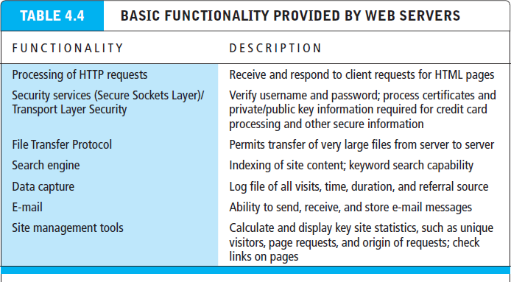

Slide 47
Site Management Tools
Basic tools
  Included in all Web servers
    Verify that links on pages are still valid
    Identify orphan files
Third-party software for advanced management
  Monitor customer purchases, marketing campaign effectiveness, and so on
  WebTrends Analytics 10, Google Analytics

Slide 48
Dynamic Page Generation Tools
Dynamic page generation:
  Page contents stored in databases as objects and fetched when needed
  Lowers menu cost (cost of changing the price of goods/services)
  Enables market segmentation
Common tools:
  Common Gateway Interface (CGI) (offers a standard protocol for web servers to execute programs)
  Active server pages (ASP) (Microsoft's server-side script engine that enables dynamically-generated web pages)
  Java Server Pages (JSP) (same purpose as above)
  Open Data Base Connectivity (ODBC), a std DB access method allows connections to any DB
Advantages
  Lowers menu costs
  Permits easy online market segmentation
  Enables cost-free price discrimination
  Enables content management system (CMS)

Slide 49
Application Servers
Web application servers:
  Is a server program in a distributed network that provides the business logic or functionality required by a website. Often viewed as a 3 tier application.
  It divides the application into
    1ST tier: front end – web browser GUI
    2nd middle tier: business logic
    3rd tier: back end – DB and transaction server

Slide 50
E-commerce Merchant Server Software
Provides basic functionality for online sales
  Online catalog
    List of products available on Web site
  Online shopping cart
    Allows shoppers to set aside, review, edit selections, and then make purchase
  Credit card processing
    Typically works in conjunction with shopping cart
    Verifies card and puts through credit to company’s account at checkout

Slide 51
Merchant Server Software Packages
Integrated environment that includes the functionality needed for ecommerce
Key factors in selecting a package
  Functionality
  Support for different business models
  Business process modeling tools
  Visual site management and reporting
  Performance and scalability
  Connectivity to existing business systems
  Compliance with standards
  Global and multicultural capability
  Local sales tax and shipping rules

Slide 52
Web Services and Open-Source Options
Options for small firms
  Hosted e-commerce sites
    Offer site building tools and templates
    Example: Yahoo’s Merchant Solutions
  Open-source merchant server software
    Enables you to build truly custom sites
    Requires programmer with expertise, time
  See table: OPEN SOURCE SOFTWARE OPTIONS

Slide 53
The Hardware Platform
Hardware platform:
  Underlying computing equipment needed for
  e-commerce functionality
Objective:
  Enough platform capacity to meet peak demand without wasting money
Important to understand the factors that affect speed, capacity, and scalability of a site

Slide 54
Right-Sizing Your Hardware Platform: The Demand Side
Customer demand:
  Most important factor affecting speed of site
Factors in overall demand:
  Number of simultaneous users in peak periods
  Nature of customer requests (user profile)
  Type of content (dynamic vs. static Web pages)
  Required security
  Number of items in inventory
  Number of page requests (Google has 40,000 per sec)
  Speed of legacy applications
SEE TABLE: FACTORS IN RIGHT-SIZING E-COMMERCE PLATFORM

Slide 55
Right-Sizing Your Hardware Platform:
The Supply Side
Scalability:
  Ability of site to increase in size as demand warrants
Ways to scale hardware:
  Vertically
    Increase processing power of individual components – e.g., using multiple processers, faster chips
  Horizontally
    Employ multiple computers to share workload
  Improve processing architecture

Slide 56
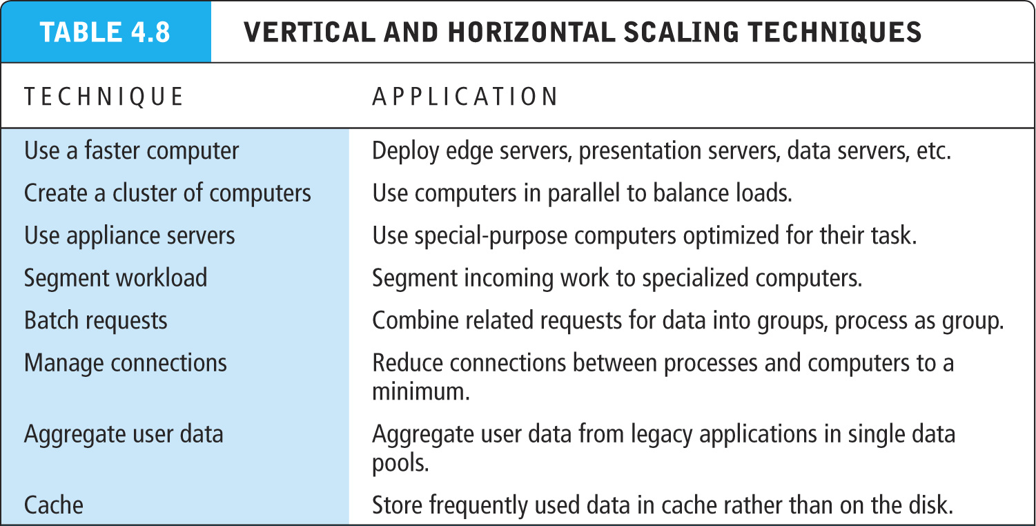

Slide 57
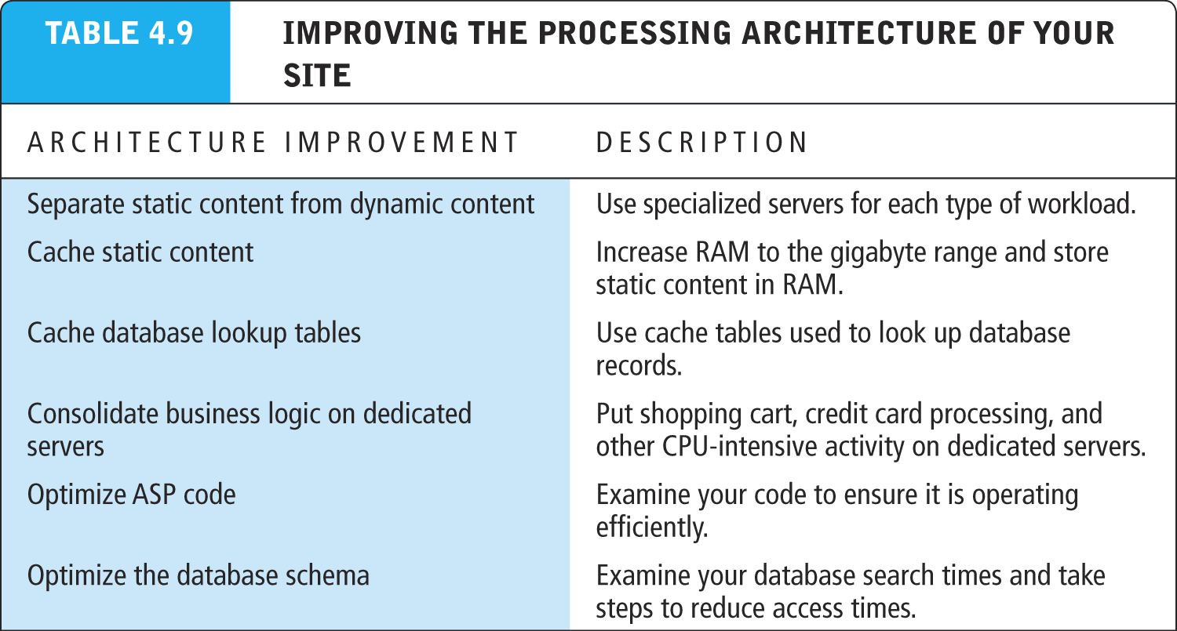

Slide 58
Other E-commerce Site Tools
Web site design: Basic business considerations
  Enabling customers to find and buy what they need
Tools for Web site optimization
  Search engine placement
    Metatags and titles, help search engines find you
    Identify market niches, and tailor site to them
    Offer expertise such as white papers, industry analysis etc. to attract customers
    Encourage links from other sites to yours
    Buy Search engine keywords and ads
    Use key words to suggest the location of your establishment

Slide 59
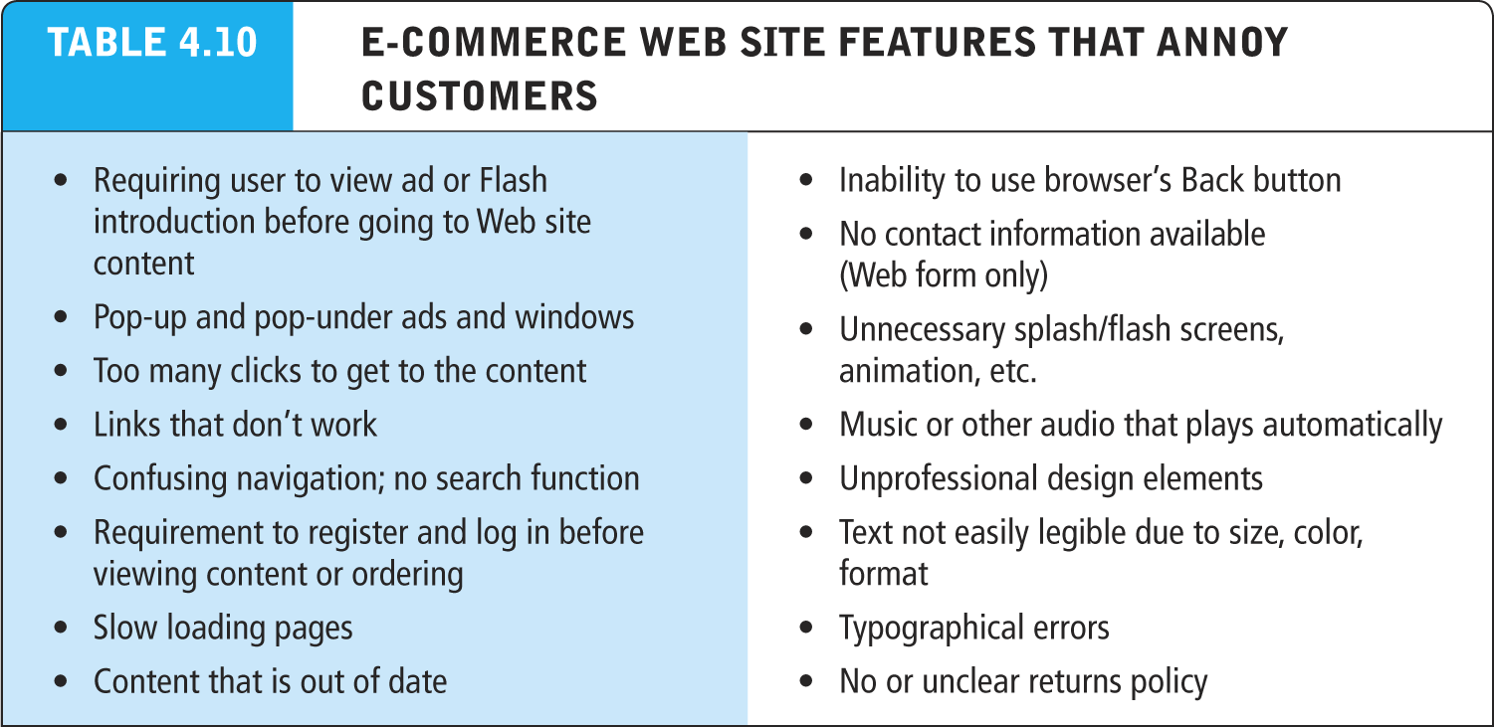

Slide 60
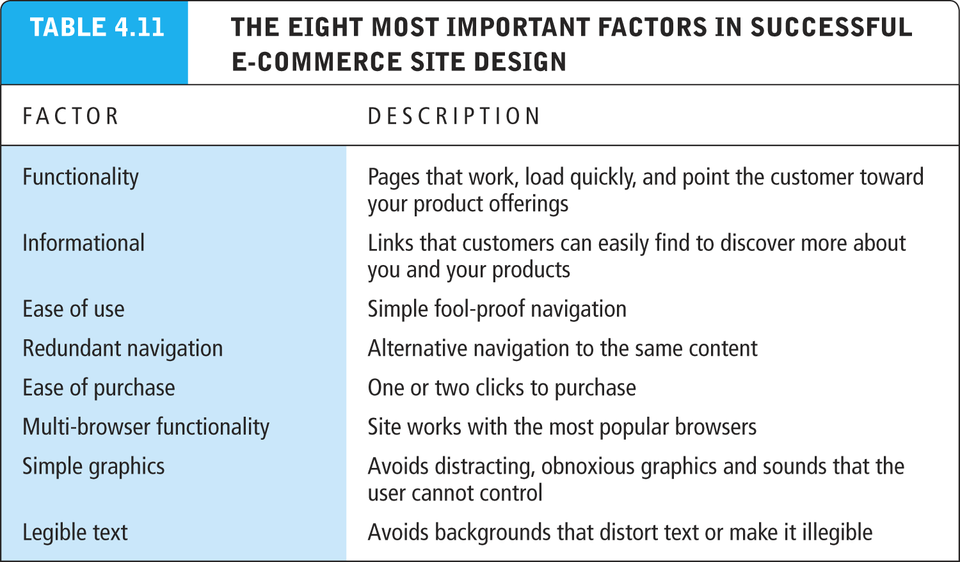
Slide 4-<number>
Copyright © 2014 Pearson Education, Inc. Publishing as Prentice Hall

Slide 61
Tools for Interactivity and Active Content
CGI (Common Gateway Interface)
ASP (Active Server Pages)/ASP.NET
Java, JSP, and JavaScript (Sun)
ActiveX and VBScript (Microsoft)
  ActiveX are technologies for content downloaded from a network, particularly from the World Wide Web.
ColdFusion (Adobe) rapid web application development platform
Web 2.0 design elements:
  Widgets (small pieces of programming code)
  mashups (functionality and data from one program used in another)

Slide 62
Personalization Tools
Personalization
  Ability to treat people based on personal qualities and prior history with site
Customization
  Ability to change the product to better fit the needs of the customer
Cookies
  Primary method to achieve personalization
    Amazon.com customizes the content of the homepage based on products you have viewed in the past

Slide 63
The Information Policy Set
Privacy policy
  Set of public statements declaring how site will treat customers’personal information that is gathered by site
Accessibility rules
  Set of design objectives that ensure disabled users can affectively access site

Slide 64
Designing for Accessibility
Why might some merchants be reluctant to make their Web sites accessible to disabled Americans?
How can Web sites be made more accessible?
Should all Web sites be required by law to provide “equivalent alternatives” for visual and sound content?
What additional accessibility problems do mobile devices pose?

Slide 65
Developing a Mobile Web Site and Building Mobile Applications
Three types of m-commerce software
  Mobile Web site
    Browser-based Internet services accessed from handheld mobile devices
  Mobile Web app built for a mobile web browser of a smart device (phone, tablet)
  Native app designed specifically for mobile device
Planning and building mobile presence
  Use systems analysis/design to identify unique and specific business objectives

Slide 66
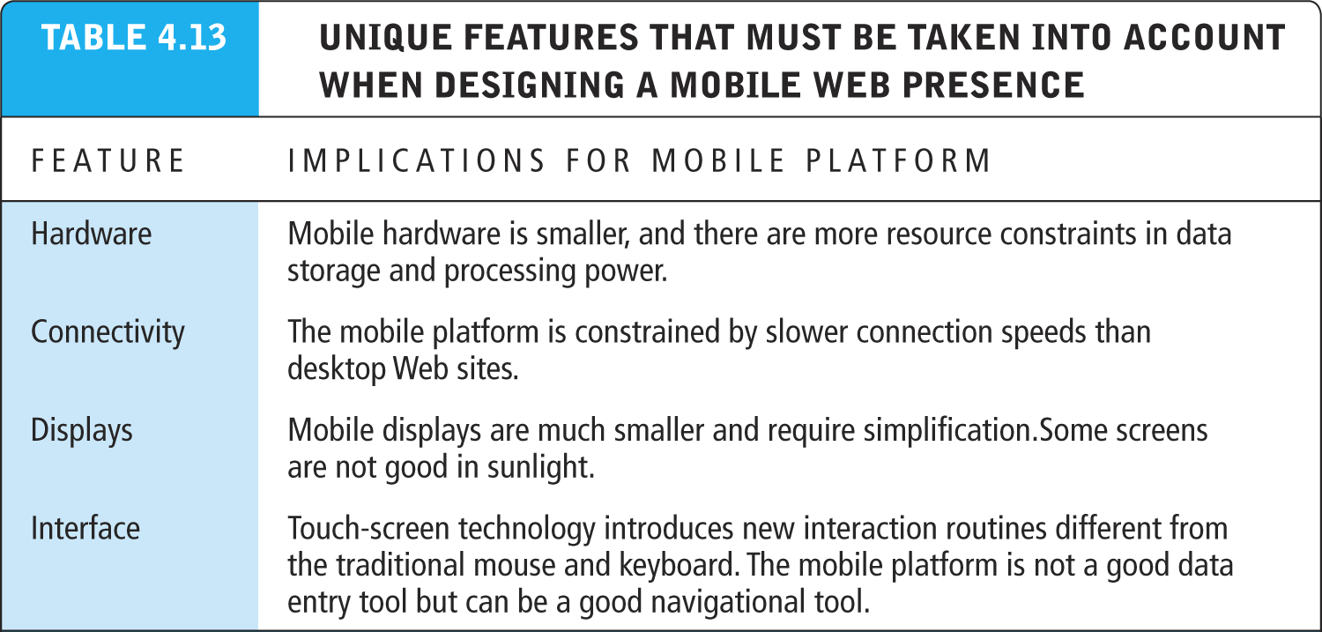

Slide 67
Developing a Mobile Web Presence
Design considerations
  Platform constraints: Smartphone/tablet
Performance and cost
  Mobile Web site:
    Least expensive
  Mobile app:
    Can utilize browser API
  Native app:
    Most expensive; requires more programming

Slide 68
Building a Mobile Presence
What are the key differences between user experience on a Web site and on a mobile device?
Why would a mobile Web site or app from the same merchant need different content or functionality?
In which cases would a merchant want to develop a mobile app over a mobile Web site?

